Slide 1
Alta Performance com Java
Java OO com Alta Performance

Slide 2
Apresentação
Atuo na área de TI desde 1996 e com Java e aplicações corporativas desde 2004. Tive a oportunidade de participar de grandes projetos para clientes como: HP, EDS, Bosch, Mitsubhishi e para os Governos de Santa Catarina, São Paulo e Mato Grosso do Sul. Atualmente me encontro imerso na cultura Ágil e palestrando em importantes eventos como Javaneiros e Flisol.
@apedrina
pedrina.alisson@gmail.com
www.alissonpedrina.wordpress.com

Slide 3
O curso
Como nasceu a ideia
Como evoluiu
Para onde vai

Slide 4
Conteúdo
A tecnologia Java - O que é? - História - Presente - Futuro - Mercado de Trabalho
Performance - O que é? - Quando Testar - O que testar - Ferramentas - Como testar
Arquitetura da JVM
O Modelo de Memória
Web
Agilidade
Clean Code
Entrega Contínua

Slide 5
Conteúdo
A tecnologia Java - O que é? - História - Presente - Futuro - Mercado de Trabalho
Performance
Arquitetura da JVM
O Modelo de Memória
Web
Agilidade
Clean Code
Entrega Contínua

Slide 6
História do Java
http://www.javatpoint.com/history-of-java

Slide 7
Green Team
James Gosling, Mike Sheridan, and Patrick Naughton initiated the Java language project in June 1991. The small team of sun engineers called Green Team.
Originally designed for small, embedded systems in electronic appliances like set-top boxes.
Firstly, it was called "Greentalk" by James Gosling and file extension was .gt.
After that, it was called Oak and was developed as a part of the Green project.

Slide 8
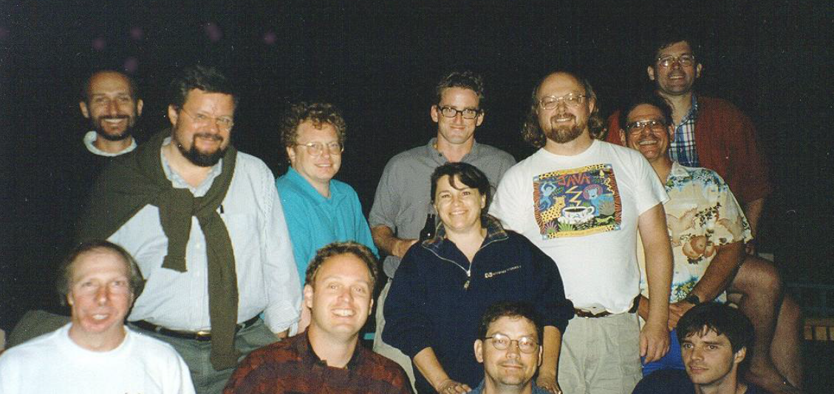
Green Team

Slide 9
Porque OAK
Oak is a symbol of strength and choosen as a national tree of many countries like U.S.A., France, Germany, Romania etc.
In 1995, Oak was renamed as "Java" because it was already a trademark by Oak Technologies.

Slide 10
Porque Java
The team gathered to choose a new name. The suggested words were "dynamic", "revolutionary", "Silk", "jolt", "DNA" etc. They wanted something that reflected the essence of the technology: revolutionary, dynamic, lively, cool, unique, and easy to spell and fun to say.
According to James Gosling "Java was one of the top choices along with Silk". Since java was so unique, most of the team members preferred java.
Java is an island of Indonesia where first coffee was produced (called java coffee).
Originally developed by James Gosling at Sun Microsystems (which is now a subsidiary of Oracle Corporation) and released in 1995.

Slide 11
Versões
JDK Alpha and Beta (1995)
JDK 1.0 (January 23, 1996) | Oak
JDK 1.1 (February 19, 1997)
J2SE 1.2 (December 8, 1998) | Playground
J2SE 1.3 (May 8, 2000) | Kestrel (hotspot)
J2SE 1.4 (February 6, 2002) | Merlin (jcp) jsr59
J2SE 5.0 (September 30, 2004) | Tiger
Java SE 6 (December 11, 2006) | Mustang
Oracle 2010
Java SE 7 (July 28, 2011) | Dolphin
Java SE 8 (March 18, 2014)

Slide 12
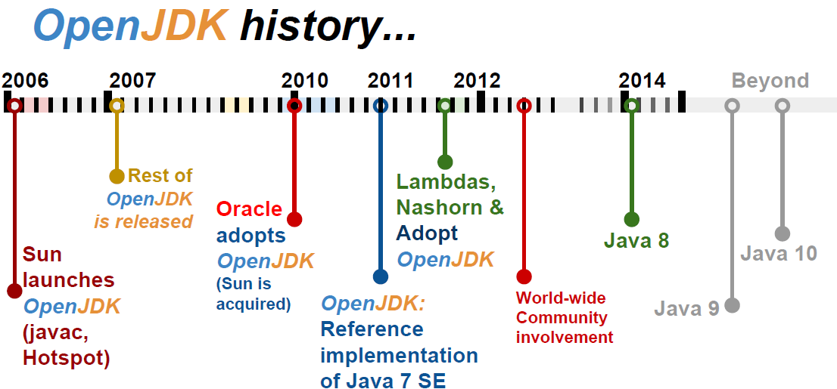
To promote and support community involvement in the development, adoption and evangelism of OpenJDK projects

Slide 13
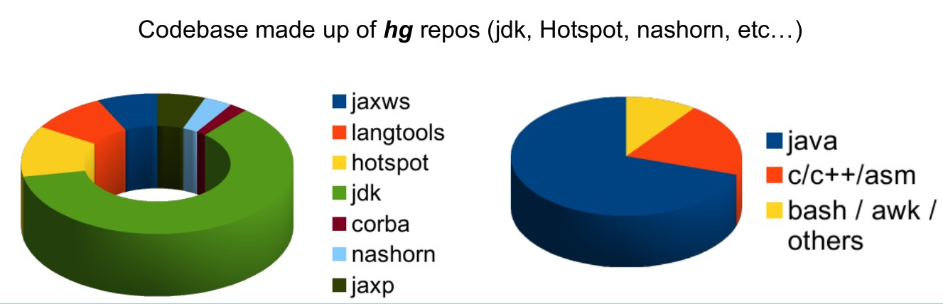
Codebase OpenJdk

Slide 14
Presente
Java hoje

Slide 15
JCP e JSR
Welcome to jcp.org, home of the Java Community ProcessSM (JCPSM) Program. The JCP is the mechanism for developing standard technical specifications for Java technology. Anyone can register for the site and participate in reviewing and providing feedback for the Java Specification Requests (JSRs), and anyone can sign up to become a JCP Member and then participate on the Expert Group of a JSR or even submit their own JSR Proposals.

Slide 16
JDK Enhancement Proposal
The JDK Enhancement Proposal (or JEP) is a process drafted by Oracle Corporation for collecting proposals for enhancements to the Java Development Kit and OpenDK.

Slide 17
Meta-circular e Linguagens Dinâmicas
Maxine - JVM
Graal VM – compilador e interpretador
Jruby
Jython
Nashorn
Scala
Groovy

Slide 18
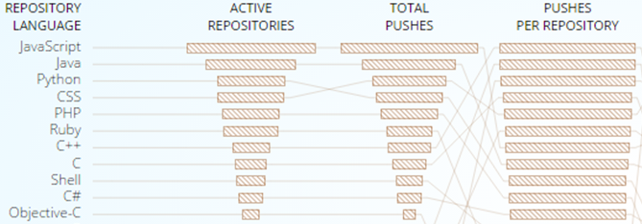
GitHub

Slide 19
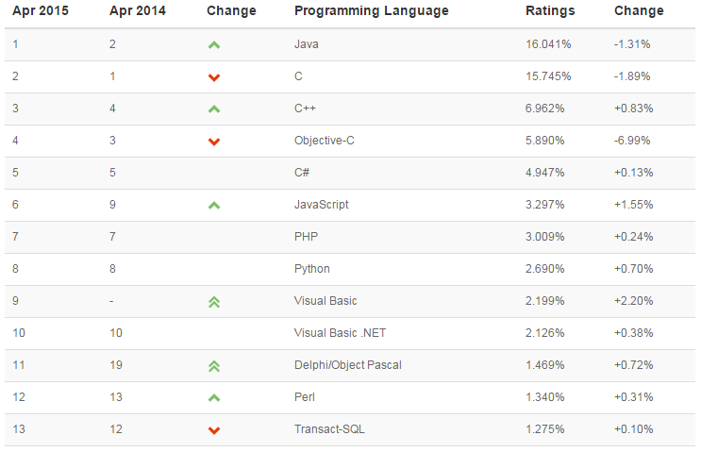
TIOB TIOBE checks more than 300 million lines of software code for its customers world-wide, real-time, each day.

Slide 20
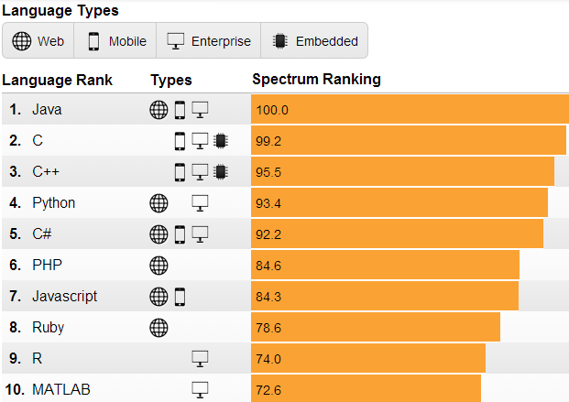
IEEE is the world's largest professional association dedicated to advancing technological innovation and excellence for the benefit of humanity.

Slide 21
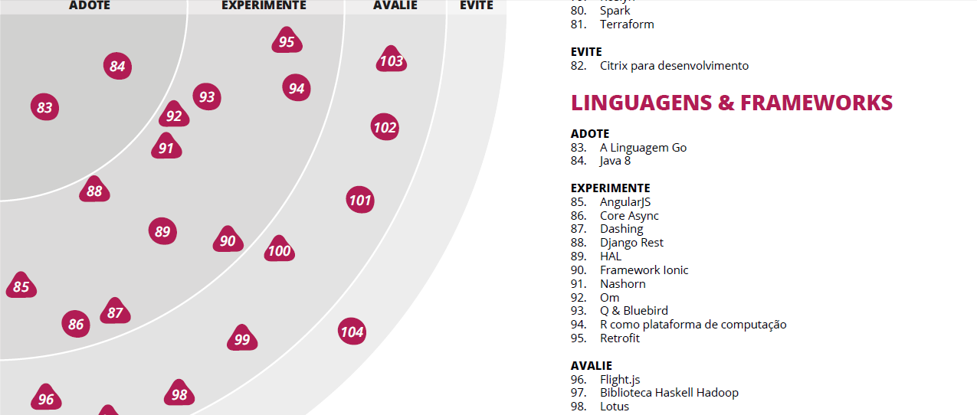
Radar thoughtworks

Slide 22
Mercado de Trabalho
No Brasil e no Mundo

Slide 23
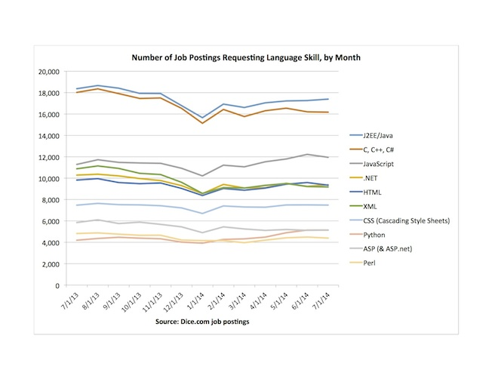
Dice.com

Slide 24
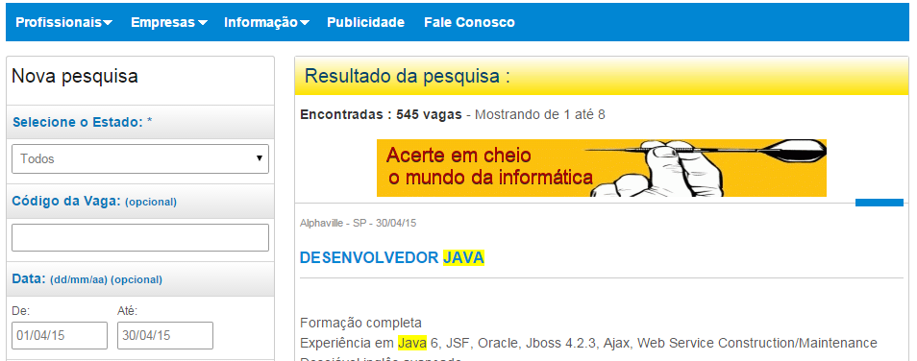
www.apinfo.com

Slide 25












Algumas empresas

Slide 26
Performance

Slide 27

What is?
Performance scalability bottleneck

Slide 28



When testing?
Early
Afternoon
Balanced

Slide 29
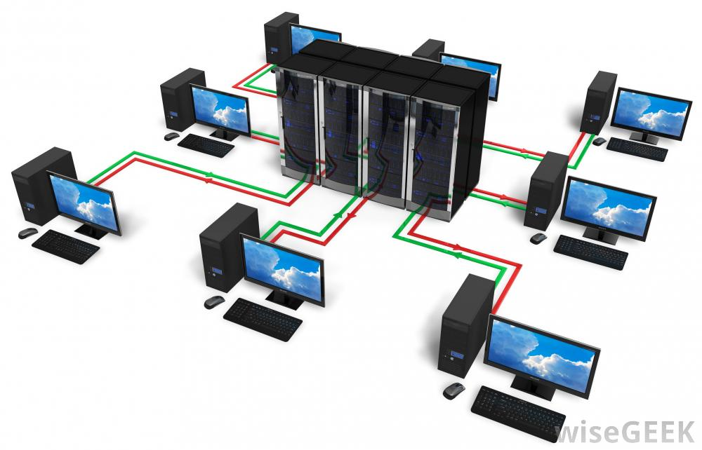
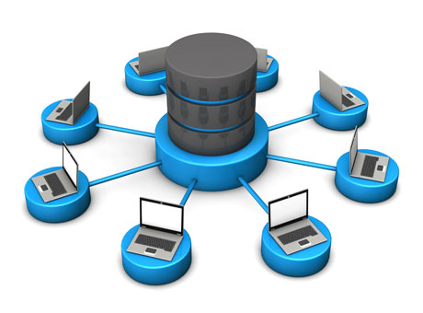
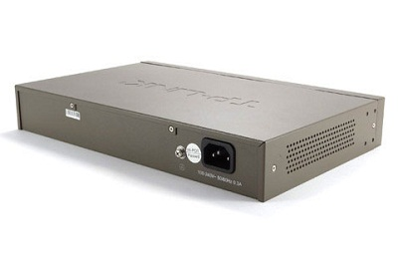
Where is bottleneck?

Slide 30
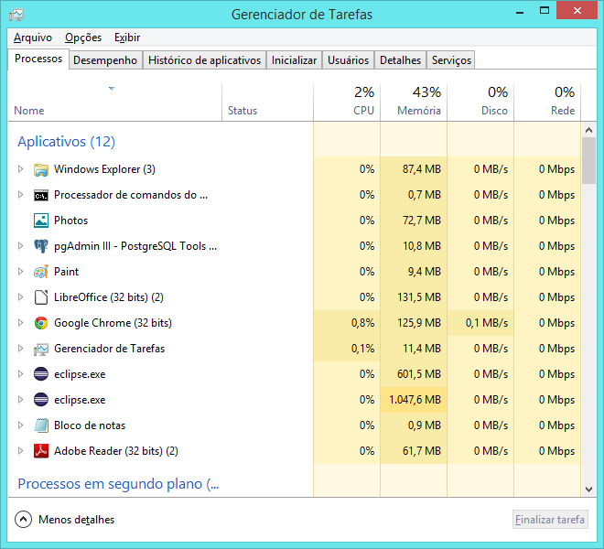
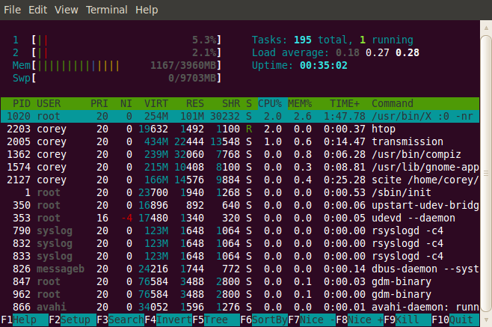
Tools

Slide 31
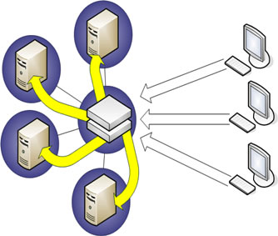
Tests
Real applications
Exact copy
Subsystems
Regression testing

Slide 32

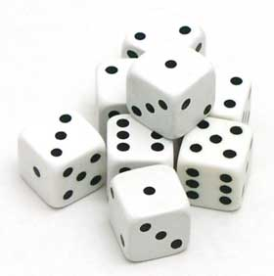
Which helps
Queuing theory
Probability

Slide 33
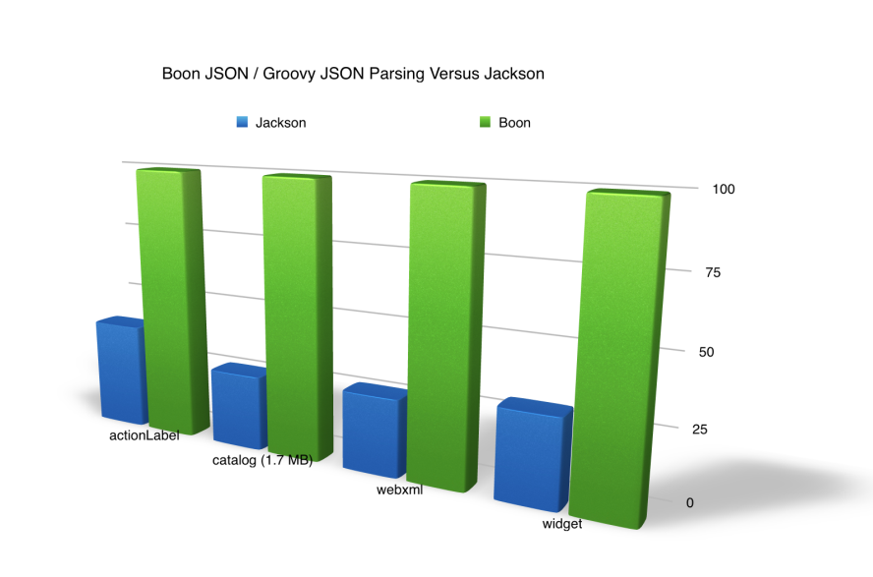
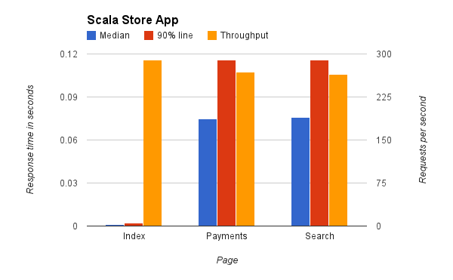
Benchmark
Microbenchmark
Macrobenchmark
Mesobenchmark

Slide 34
Which mesuare
Response Time
Batching
Latency
Throughput
Scalability
Stress Testing

Slide 35
Stress Testing
if you find yourself running tests for more than 24 hours you are doing a stress test.

Slide 36
Scalability
is the measure of how your system responds when additional hardware is added.

Slide 37
Throughput
transactions per second your application can handle (motivation / result of load testing). A typical enterprise application will have lots of users performing lots of different transactions. You should ensure that your application meets the required capacity of enterprise before it hits production.
Throughput
OPS/TPS /RPS e média de tempo
Ex: 500ops em 0.5s x 400ops em 0.4s

Slide 38
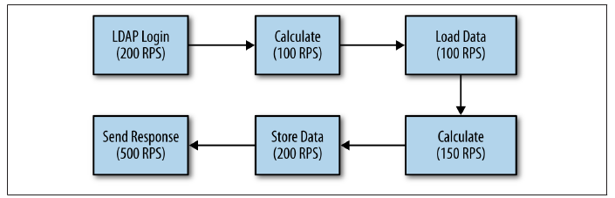
What is that?

Slide 39
Response Time
Amount of time system takes to process a request after it has received one. For instance you have API and you want to find how much time that API takes to execute once invoked, you are in fact measuring response time.

Slide 40
Latency
In simplest terms this is Remote Response time. For instance, you want to invoke a web service or access a web page. Apart from the processing time that is needed on the server to process your request, there is a delay involved for your request to reach to server. While referring to Latency, it’s that delay we are talking about.
Networking virtualization

Slide 41
Response time
Think time
Média tempos somados dividido pelo número de request
Porcentagem 90%, 5%, etc

Slide 42
Tips
Variability
Probability
Do not sacrifice solide principles of architecture in exchange for performance
Try to create good programs rather than fast, unless…

Slide 43
Arquitetura da JVM

Slide 44
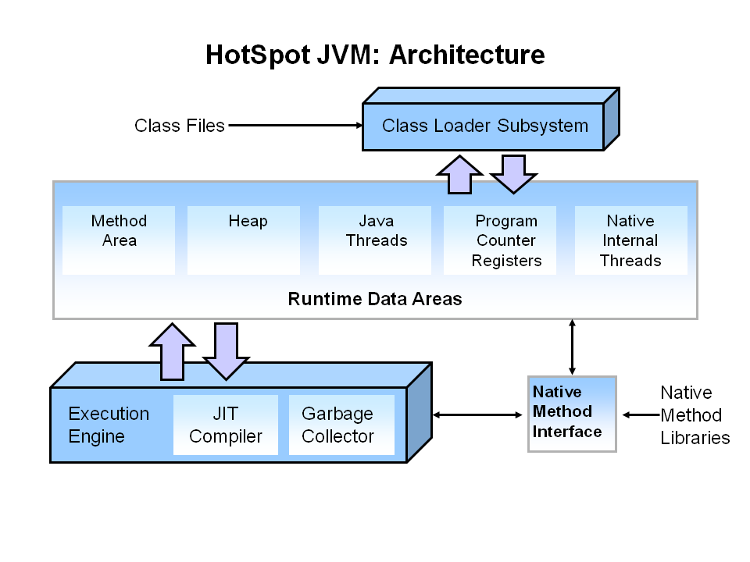
Visão Geral

Slide 45
Modelo de memória

Slide 46
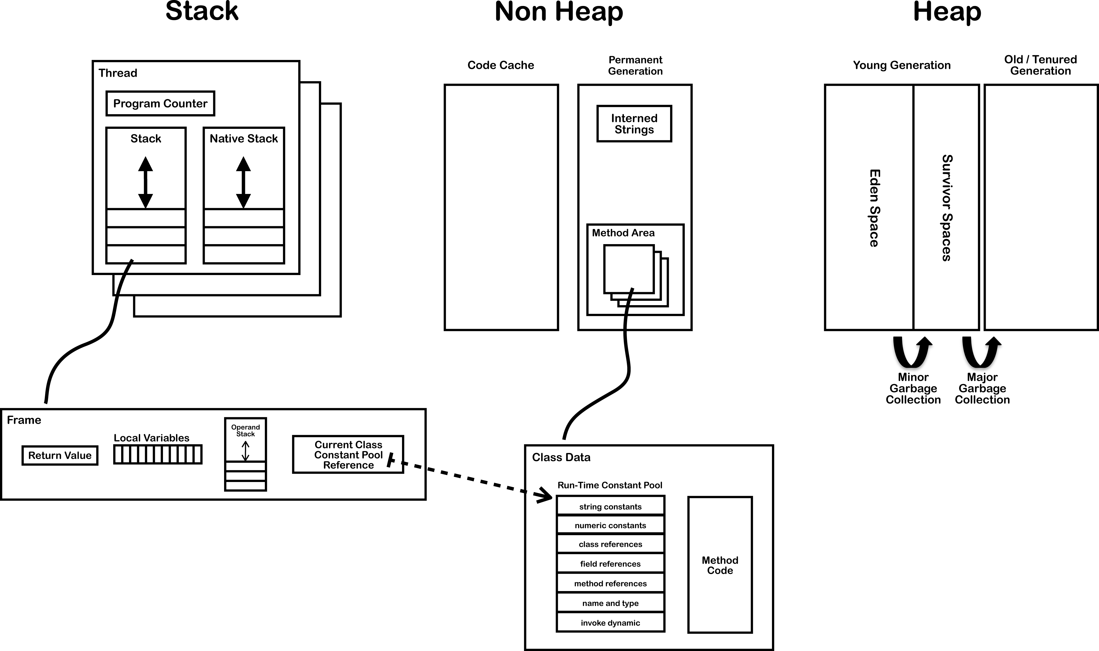
Modelo de memória

Slide 47
Garbage Collector

Slide 48
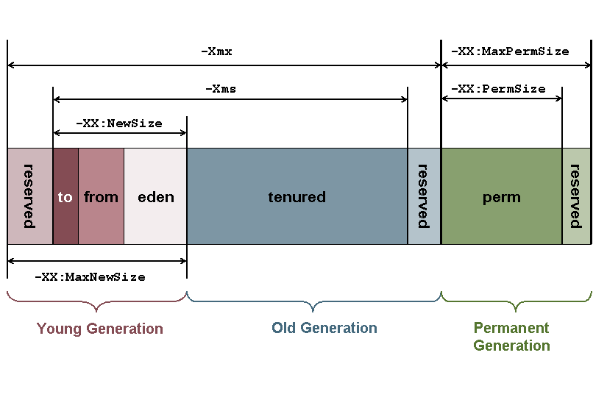
Garbage Collector

Slide 49
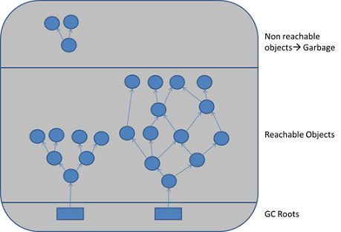
Tempo x Espaco

Slide 50
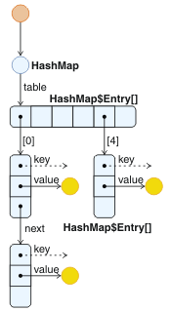
Referência x Objeto

Slide 51
The jdk tools

Slide 52
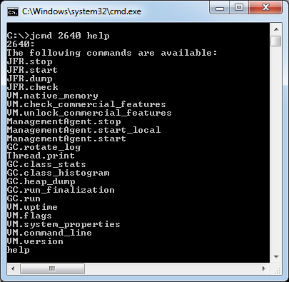
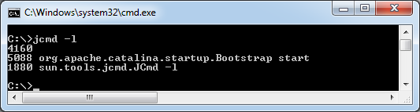
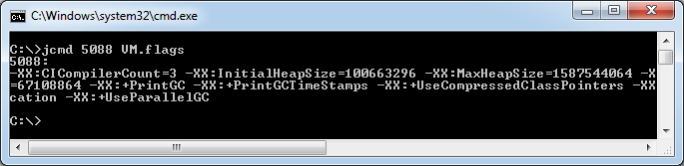
jcmd

Slide 53
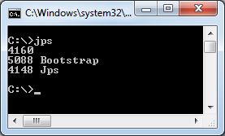
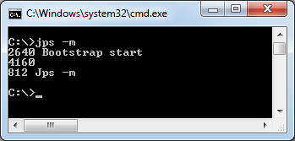
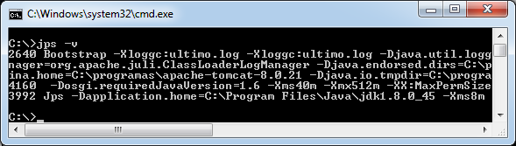
JPS

Slide 54
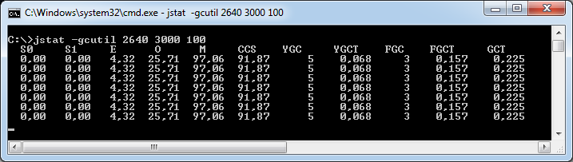
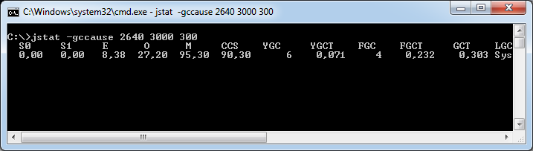
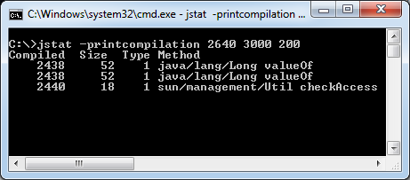
jstat

Slide 55
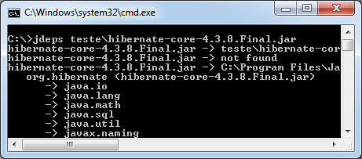
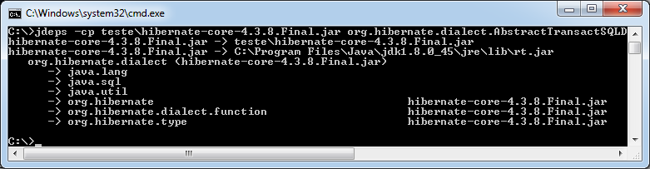
jdeps

Slide 56
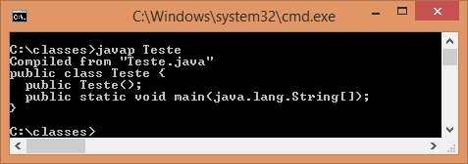
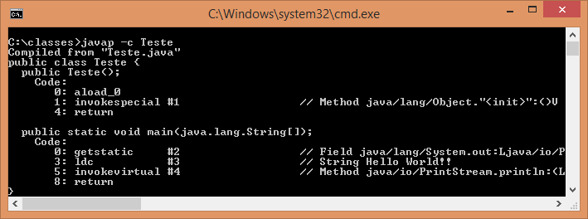
javap

Slide 57
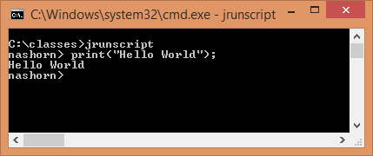
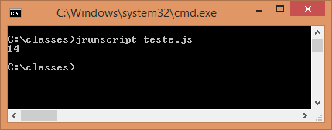
jrunscript

Slide 58
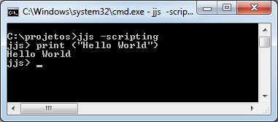
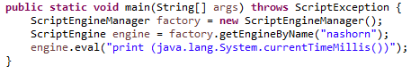
jjs

Slide 59
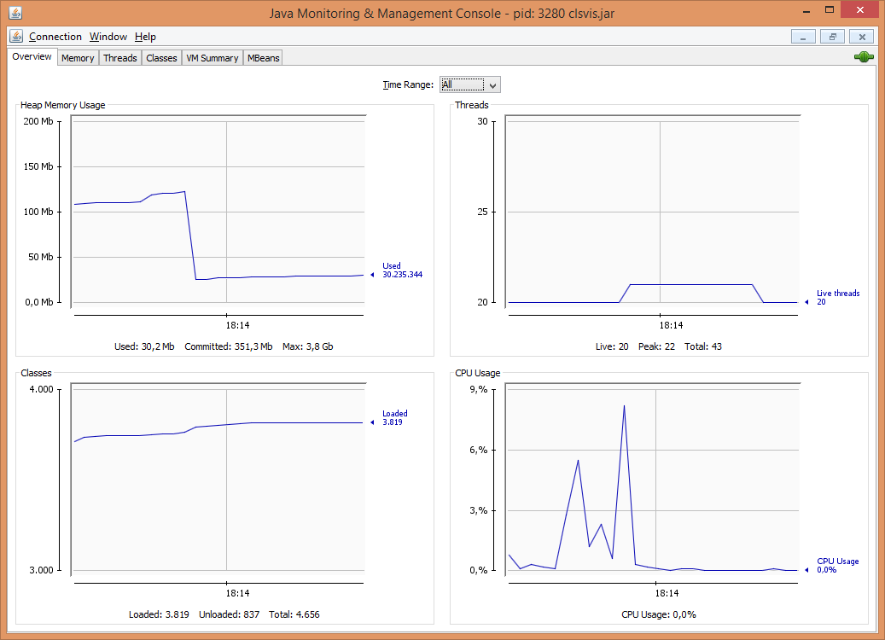
jconsole

Slide 60
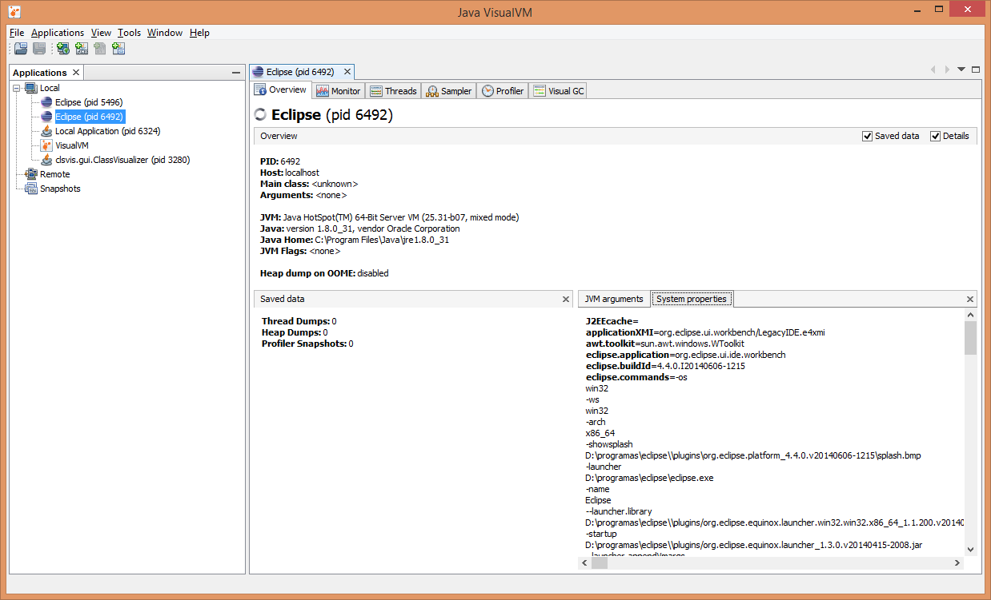
jvisualvm

Slide 61
Arquitetura
DDD, SOA, Microservices e outros

Slide 62
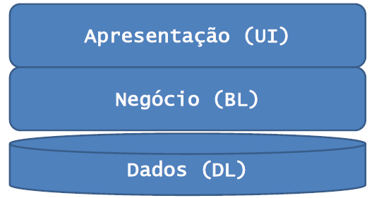

Slide 63
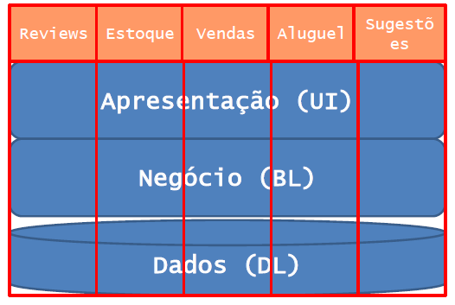

Slide 64
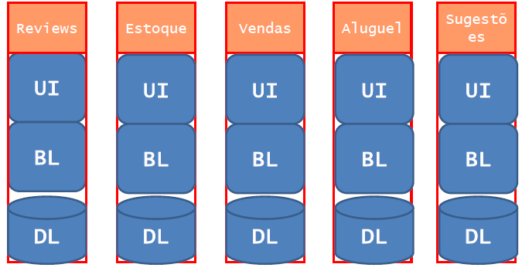

Slide 65
